Slide 1
Pain in the Nation Issue Brief: Alcohol and Drug Misuse and Suicide and the Millennial Generation — a Devastating Impact
This issue brief is a continuation of Trust for America’s Health and Well Being Trust’s Pain in the Nation: The Drug, Alcohol and Suicide Crises series. The Pain in the Nation series helps inform and create a comprehensive National Resilience Strategy.
@HealthyAmerica1

Slide 2
Why Focus on Millennials?
Record numbers of deaths due to alcohol and drug misuse and suicide
More than one-third of the workforce
Largest proportion of Americans serving in the military.
About a quarter lack health insurance
Many are burden by education debt
Many are or will be parents, responsible for the well-being of young children
Notes:
(

Slide 3
Key Findings

Slide 4
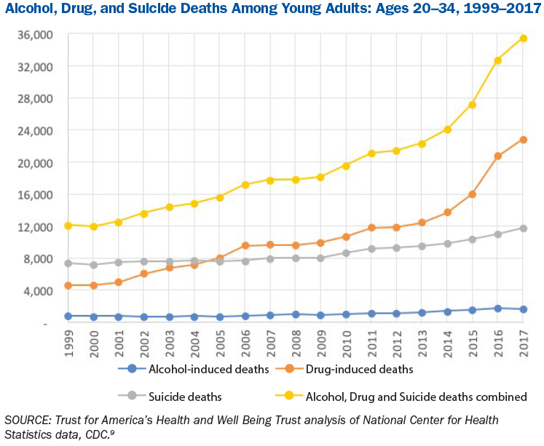

Slide 5
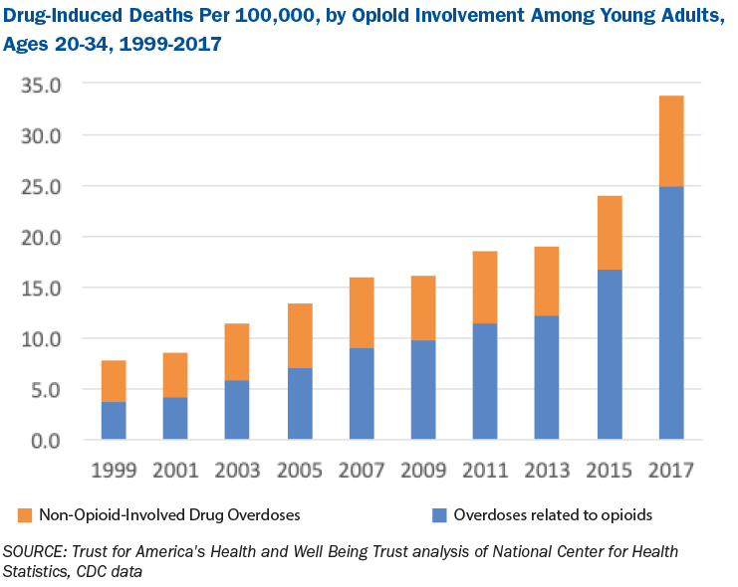

Slide 6
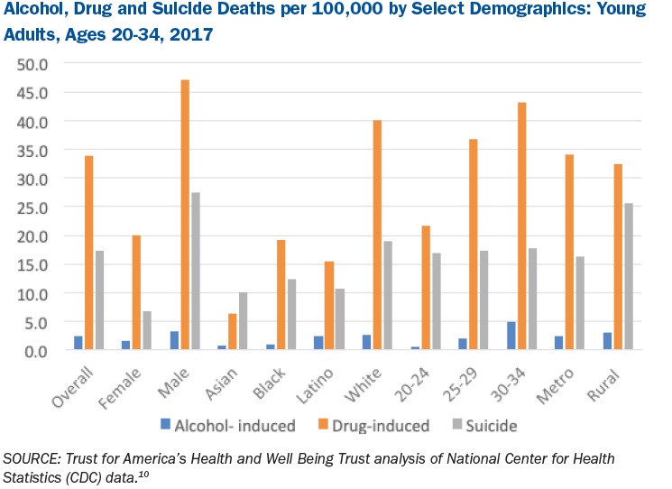

Slide 7
Key Recommendations
Assure patient access to evidence-based prevention, screening and treatment. Care must be culturally informed, medication-based substance misuse treatments should be available and covered by insurance.
Use pricing strategies to limit consumption of alcohol by adolescents and young adults.
Prioritize the implementation of the Family First Prevention Services Act to support prevention services for families in crisis and reduce foster care placements.

Slide 8
Key Recommendations Continued
Invest more in research on and education about non-opioid and non-drug pain treatments.
Provide evidence-based substance misuse treatment within the criminal justice system and ensure that treatment continues and that employment opportunities exist after release.
Create substance misuse and suicide prevention programs that address the crisis in multiple settings and in novel ways, including by meeting young adults where they are.

Slide 9
Key Recommendations Continued
Use telehealth to provide treatment in underserved areas.
Hospitals and birthing centers should screen new mothers for substance misuse disorders at delivery.
Transition programs for veterans returning to civilian life should be readily available.

